Slide 1

Jeroom Remmers, director TAPP Coalition May 23th 2023
PlantEurope online event
Working Towards The Inclusion of a Plant-Based Diet in Public Policy
The Dutch ‘fair meat price’ success case. How Pigouvian taxes can lead towards a more sustainable diet.

Slide 2
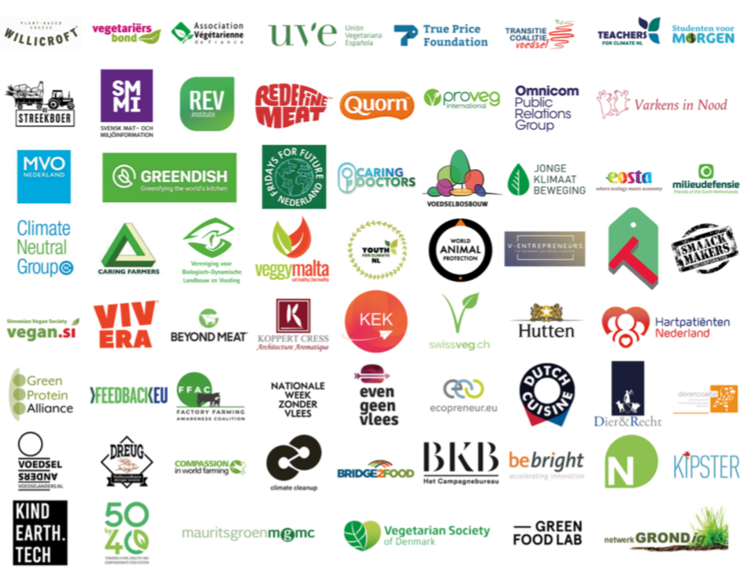
True Animal Protein Price Coalition
Who are we?
60+ partners in the TAPP coalition with various backgrounds
Representing over 0,6 million EU citizens
Partners in USA and EU countries
Over 5000 companies & ngo’s in > 100 countries supported our carbon pricing food campaign in 2021.

Slide 3
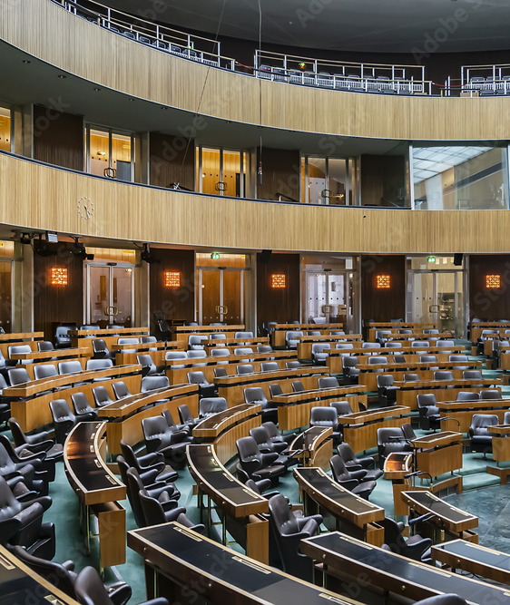
owardS a true price for animal products
What do we do?
Reports on true pricing/fiscal incentives
Policy advocacy in EU / Member states
Global and consumer campaigns
Catering projects with higher meat prices

Slide 4
Introduction
CE Delft reports
Sustainability charge on meat
Pay as you eat meat, dairy, eggs
TAPP report
‘Aligning food pricing policies with the European Green Deal’
EU Parliament
5th Feb 2020
Vote in 2021 on VAT reform food

Slide 5
Dutch succesS
Petition meat tax signed 50.000 x in 4 weeks
2 governmental political parties included meat tax in election programme (+ 2 others)
Agriculture Ministry developed meat tax proposal based on TAPP plans
Agriculture Minster announced study how to tax meat – financing farmers
However, majority vote in Parliament 2022 not to tax meat
Majority vote Parliament pricing GHG-emissions / nitrogen livestock / end low meat prices
Ministerial proposal for taxing meat and dairy for 2030 climate goals
Supermarkets announce higher prices for sustainability label livestock farmers
eg 5 eurocents per liter milk = 0,5 euro per kg cheese based on AH label

Slide 6
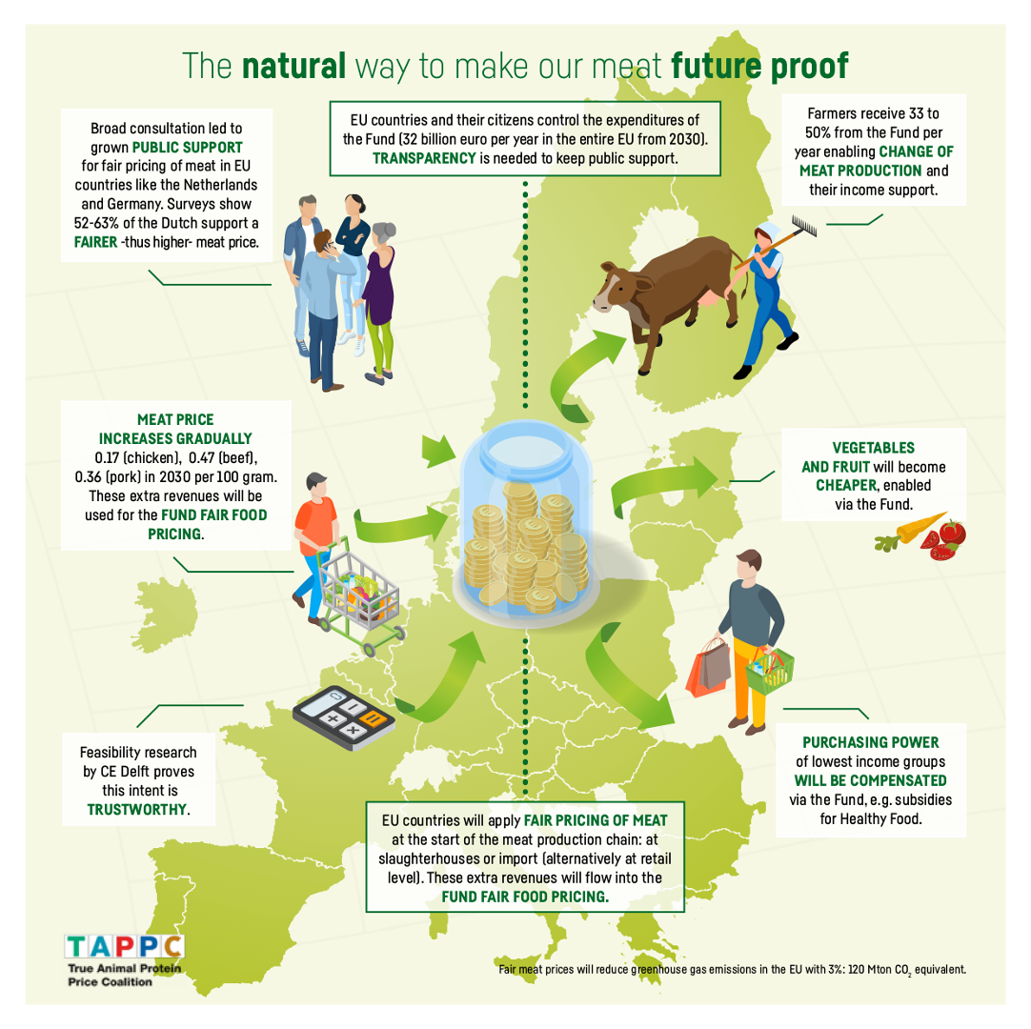
TAPP’s Dutch success story explained
A coalition of farmers, environmental and animal
welfare groups, companies, doctors, youth
Credible scienced based policy proposals
We prove we represent the majority (surveys)
Presence in media ; petition etc.
Good contacts with political parties
Support from scientists and ambassadors
TAPP Coalitions in other countries ? !

Slide 7
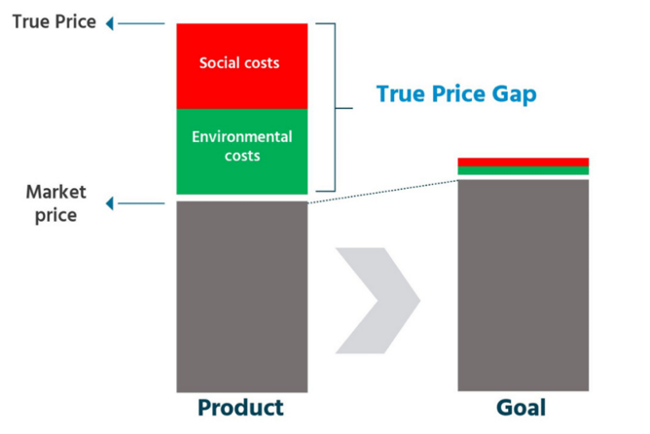
Food prices do not reflect all production costs
→ environmental & health costs + income farmers.

Slide 8
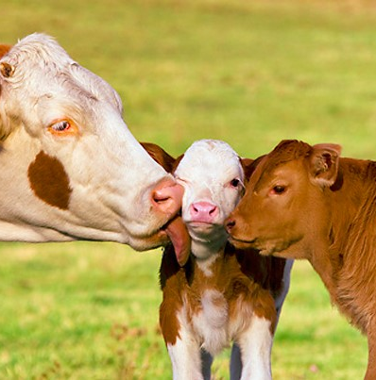
arm to fork strategy
EU Farm to Fork Strategy (Green Deal for food)
‘Tax incentives should drive transition to sustainable food system’
’EU tax systems should ensure food prices reflect the true costs’
Message Farm to Fork Strategy:
We eat too much meat
Avoid very low meat prices
→ code of conduct → legislation

Slide 9
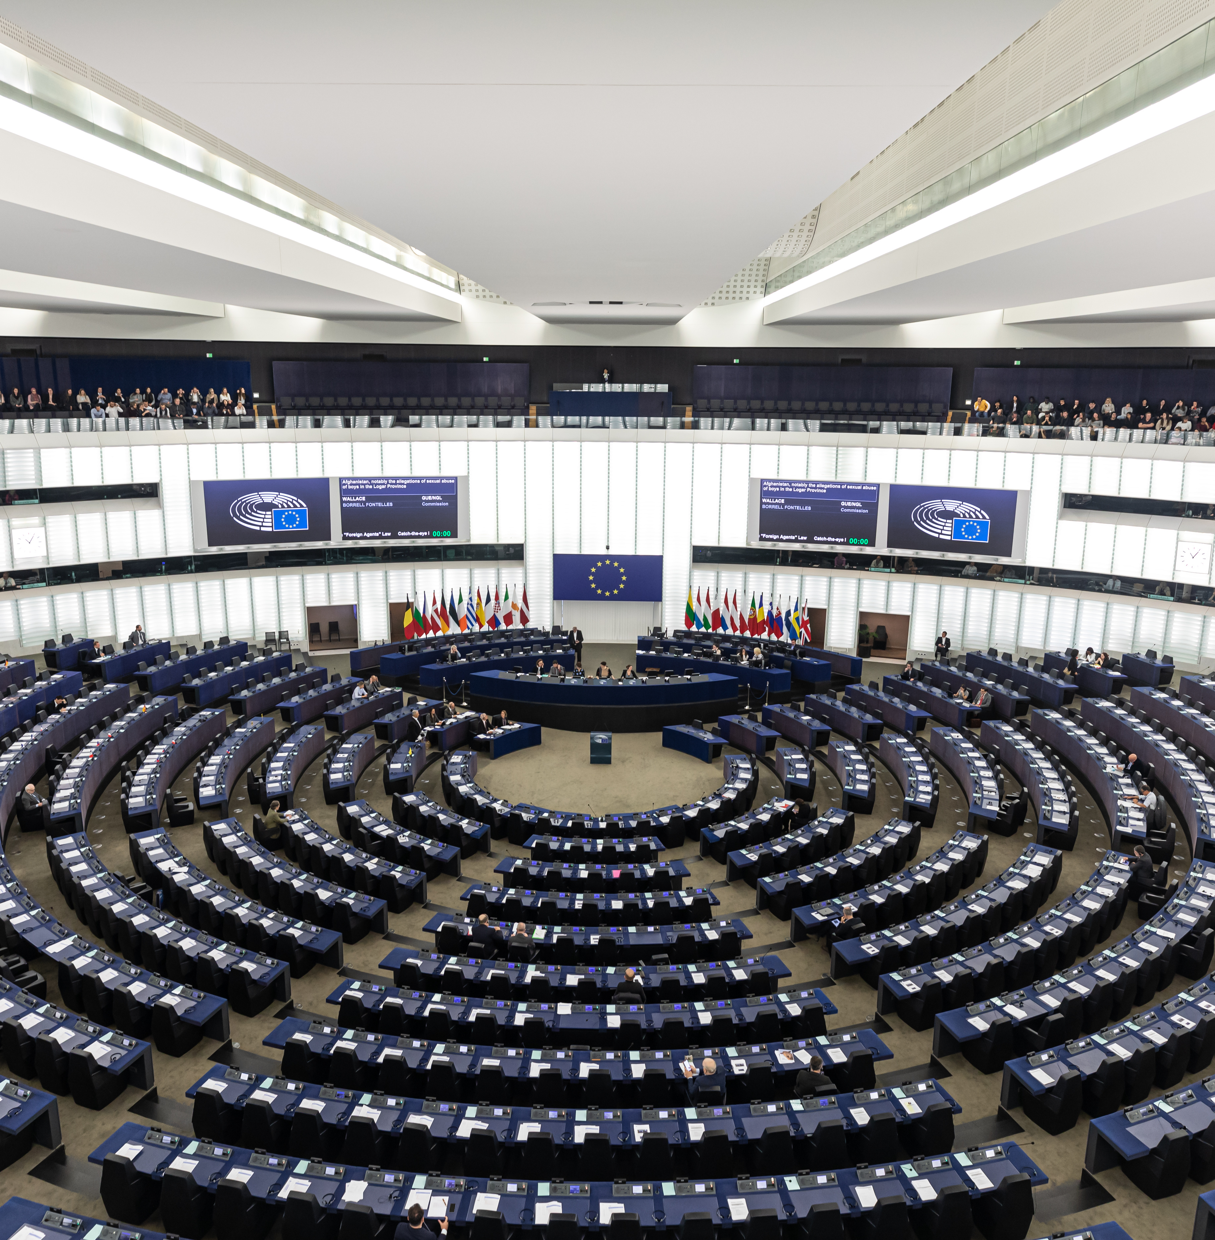
Majority EU Parliament: reform VAT on food
0% VAT healthy/sustainable food
Increase VAT food which negatively impacts health/environment
Amendment 27, Farm to Fork Strategy 2021

Slide 10
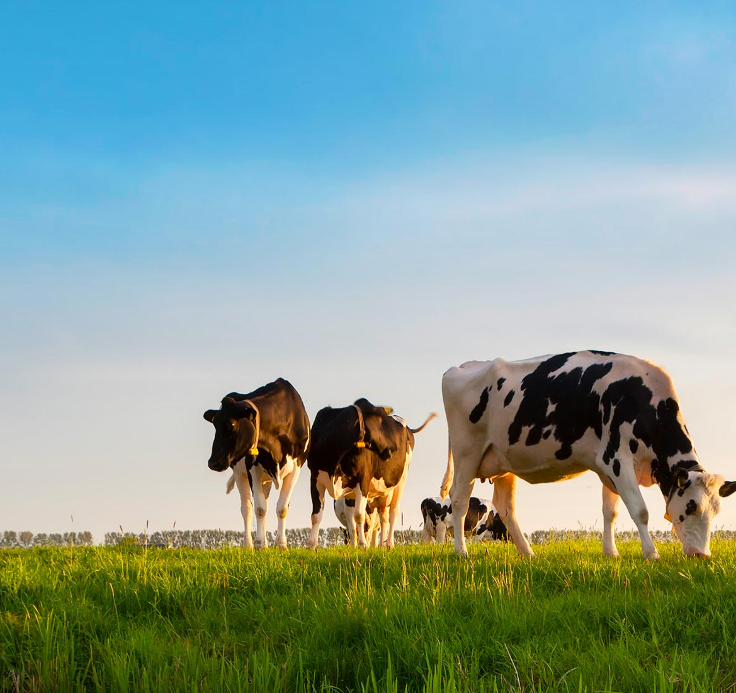

How ready are people in the Netherlands and Eu countries for higher taxes on meat and animal products? Results Ipsos survey feb 2023 More info: https://www.tappcoalition.eu/nieuws

Slide 11
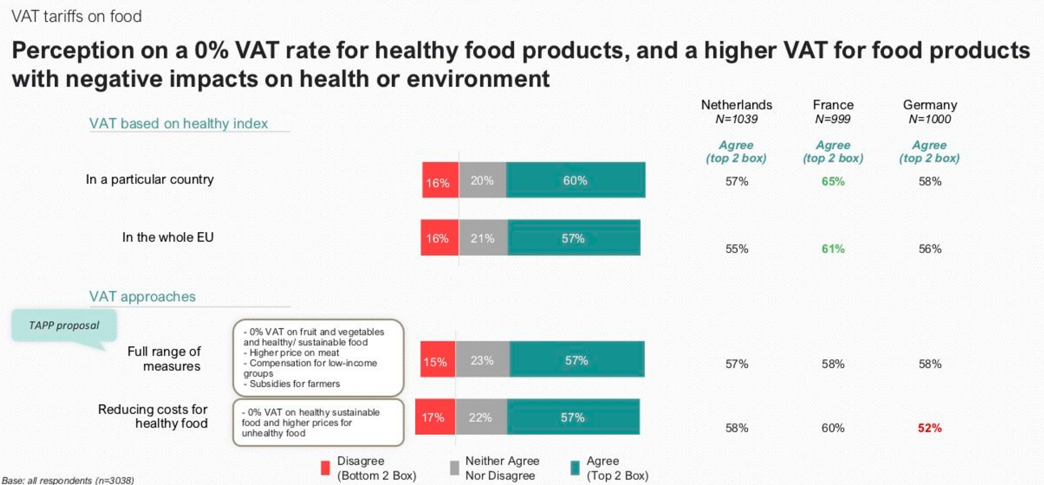

Slide 12
Support TAPP Coalition proposal
57% support for:
True meat price
0% VAT on healthy and sustainable food products
Extra payments to farmers
Compensation for low-income groups
Similar results from DVJ insights survey 2021
EU Barometer 81% support EU consumers
Notes:
food prices should reflect the costs for society

Slide 13
Polluters pay principle
70-75% prefer supermarkets/consumers pay GHG emission tax
Let farmers pay
Let supermarkets/consumers pay
Notes:
Polluter Pays Principle: let supemarkets/consumer pay, don’t touch our farmers !

Slide 14
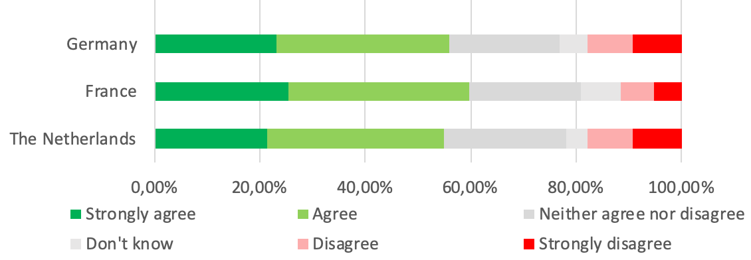
10% lower expenditures on food (€ 250/year)
0% VAT fruit, vegetables, bread, grain products, coffee, tea, organic and fair trade food, meat/dairy substitutes.
Non-organic meat / dairy normal , highest VAT rate.
Free food vouchers: € 15/month organic food, vegetables or fruit.

Slide 15

SUMMARY
60% West-European consumers agree taxing meat and dairy, if healthy food becomes cheaper: 0% VAT veggies/fruit
CE Delft report proved feasibility food tax reform
EU Parliament supports VAT-reform (TAPP)
Support from important Member States
What are we waiting for?

Slide 16
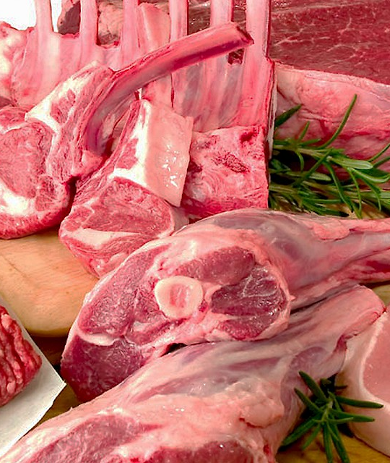
calculation model Which factors are included?
True price model meat tax
Factors included: GHG-emissions, nitrogen, particulate matter, landuse/biodiversity loss (environmental costs per kg meat)
beef, pork, chicken: emission per kg meat
Each factor has a price, e.g. 90 euro per ton CO2 eq
Meat tax calculated for each meat type
Other factors not included yet:
More environmental factors like eco toxicity
health costs per kg red and processed meat
Animal welfare costs per kg meat
Living wages for farmers

Slide 17
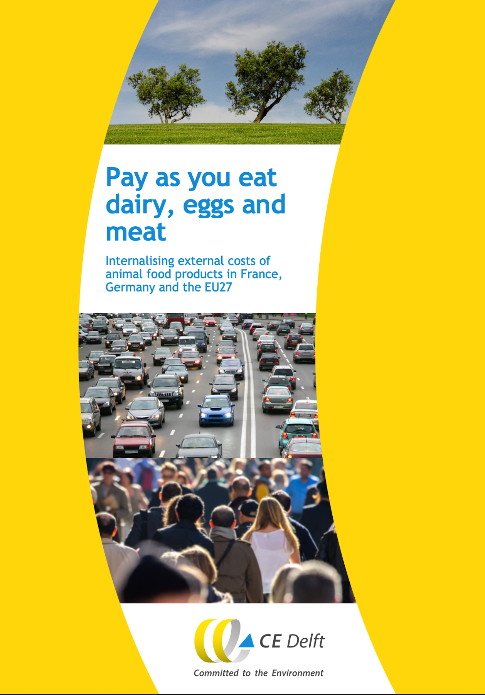
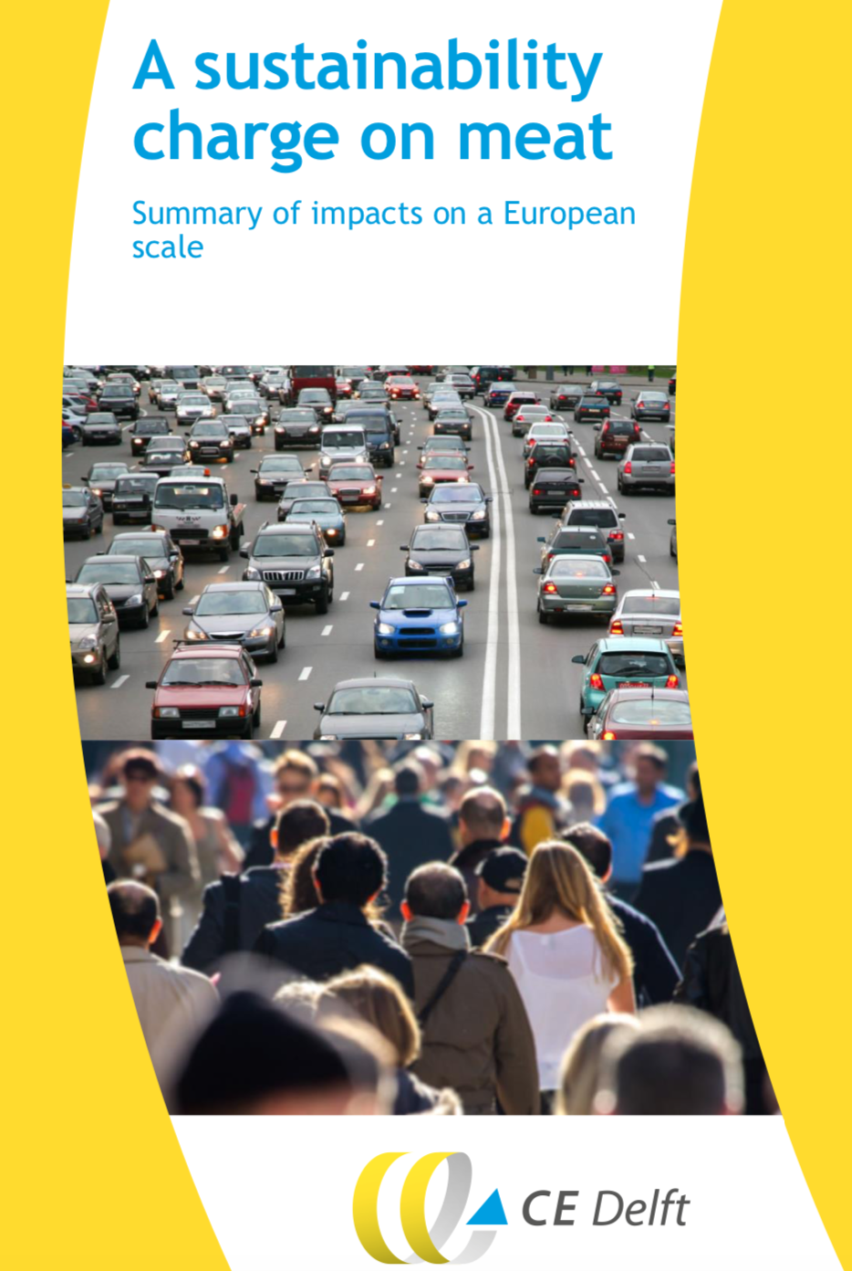

Report “sustainability charge on meat’ eggs and meat”
Data provided by

Slide 18
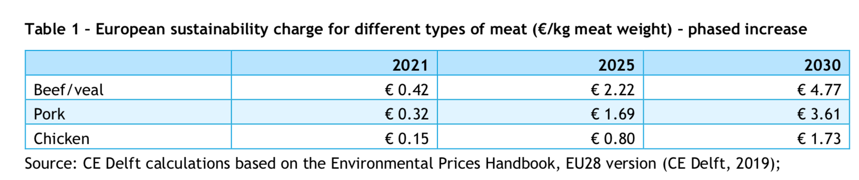
MEAT TAX IN EU-28
EFFECT: 3% REDUCTION EU GHG-EMISSIONS

Slide 19
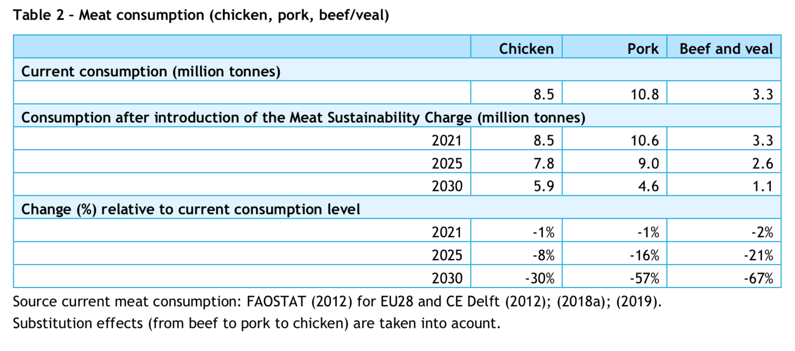
Results meat tax : 50% reduction of consumption 2030

Slide 20
onsumer tax/levy compared to retail price
RETAIL PRICE & TRUE PRICE (TAX INCREASE)
’Pay as you eat meat, dairy, eggs’

Slide 21
How do we assure households with a low income are not disproportionately affected?
50% or 100% of meat tax revenues can be used to reduce costs of healthy, sustainable food
We suggest 20% lowest income groups are compensated fully for increased costs of meat (e.g. 10 euro/month)

Slide 22
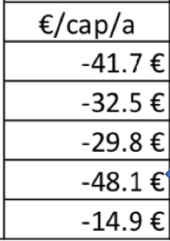
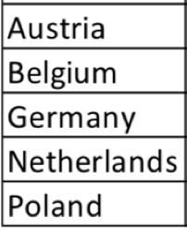

NET BENEFIT CONSUMERSet benefit consumers
High VAT on meat & dairy, 0% VAT vegetables, fruit, cereals, bread.
Food overall 10% cheaper is possible

Slide 23
difficulties and how did we deal with it?
Difficulties Solutions
Attacks from farmer community Show farmers support us
Attacks from right wing newspaper Publish positive articles
Attacks from meat lobby Always reply, we represent majority
VVD/CDA political parties Show majority of their voters support us
VVD/CDA sustainability networks action
Develop alternatives they can support
Meat prices are very high already Lower taxes healthy food, tell taxes work;
majority increased

Slide 24
a backlash, how to keep support of society and political majority?
Backlash: vote against meat tax May 2022
New Ipsos survey showing support of majority
Develop alternative proposals supported by a political majority to keep the topic on the agenda

Slide 25

limate & biodiversity goals depend on how we eat
Example transferable to other countries?
"We are on a highway to climate hell”
Denmark & New Zealand: GHG-emission tax livestock
Denmark, Baltic States, Bulgaria: highest VAT on meat/dairy
Spain, Italy: low VAT rate healthy food, higher VAT on meat/dairy
EU-Commission preparing GHG emission tax ETS livestock for 2026
UN Secretary-General

Slide 26
tAPP Proposal presented yesterday in berlin
Deutsche Umwelthilfe & TAPP event : IPSOS-consumer survey / CE Delft
My hopes for the next steps in our work? EU & EU countries
Framework Sustainable Food Systems (FSFS) & proposal ETS system for agriculture/livestock, both coming autumn 2023
End 2023 Danish proposal taxing GHG emissions livestock/food
Germany : FDP Finance minister is still blocking taxes
Netherlands: tax on GHG & nitrogen emissions for livestock

Slide 27
EU FSFS: Polluter Pays Principle for food riority 2: polluter pays principle
PPP in agri & food policies climate/pollution
Farmers or supermarkets should pay for GHG-emissions (ca. 90 euro/ton)
Increase EU import taxes on meat, dairy, soy / animal feed
VAT reform on food in the EU and ETS for livestock
Social Food & Climate fund
Meat taxes needed to pay for loss & damage fund (UN Climate summit)
EU legislation to end low meat price marketing , EU restrictions advertising
Green label Planet-Score

Slide 28


Slide 29
THANKS FOR YOUR ATTENTION!
Questions?
https://tappcoalition.eu
info@tappcoalitie.nl
0031 6 22 40 77 12

