Slide 1
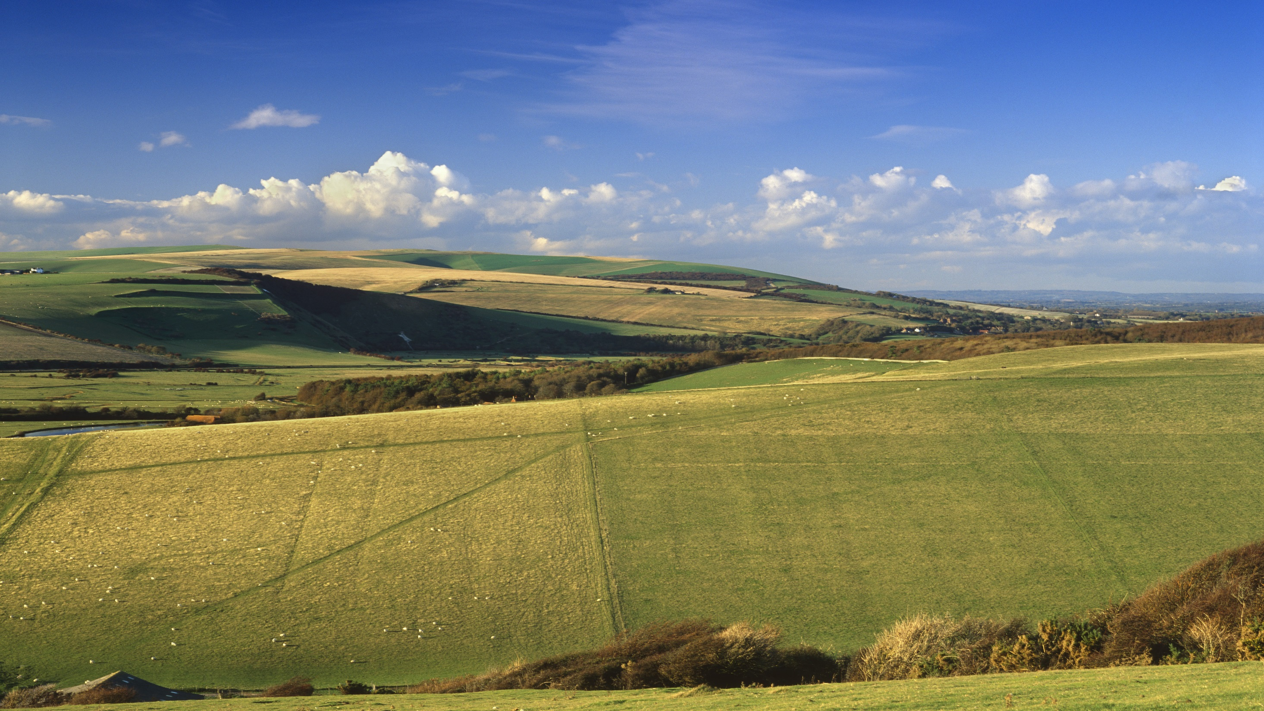

What can eating plants do for climate and nature? Lessons from the UK’s NFS
Dustin Benton
Policy director, Green Alliance
Notes:
Try to tell you three things:
How did we do the NFS (pull back the curtain a little)
How we thought about the causes of what was going wrong with the food system, and how this related to our recommendations (including how we thought about power)
Highlight a few of the key recommendations
All in 10 mins! So no way to be comprehensive.

Slide 2


Notes:
First root and branch review of the food system in ~75 years. Builds on a series of more partial strategy reviews.
Huge programme of engagement ~75 visits (including public dialogues on what issues people wanted to change); hundreds of world-class experts provided time to discuss/new research.
Ended up writing two reports because COVID: first was on covid (mainly poverty) and trade (because Brexit was due to happen). Latter was on the whole system and what I’ll focus on.
Important to know that (a) remit was agreed by ministers in advance which looked explicitly at sustainability; (b) it gave the NFS team VERY wide discretion to determine our process and approach. We built advisory groups which were used to test evidence and recommendations (very expansive across farming, food businesses, civil society and citizens); we had less freedom over the citizen engagement but engaged very widely; and we sought out the experts without fear or favour. Very powerful to have an independent review which was set inside gov’t as it gives you huge convening power. Not likely possible to do without gov’t power + freedom.
Also VERY strong sense of mission amongst team across health, environment, inequality, with a decision to put experts into the team rather than contract out.

Slide 3

The causes
Notes:
Our diagnosis

Slide 4
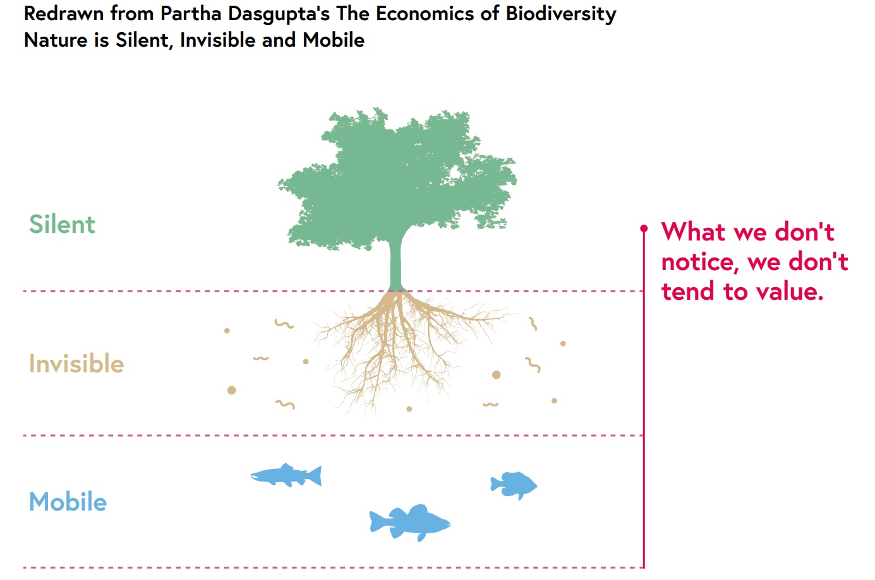
Two feedback loops are responsible
The Invisibility of Nature
The Junk Food Cycle
We have an innate preference for calorie dense food
It is easier to sell us these foods
Companies invest time and money creating these foods
Greater availability, promotions and marketing mean we eat more of these foods
The market for these foods grows so we innovate to make them cheaper
Our preferences are reinforced
Notes:
There are 2 main concepts the report highlights. These highlight the issues facing the food system and provide the context for the recommendations
The Invisibility of Nature – lack of a feedback loop
Nature is invisible to the metrics that drive economy activity e.g. GDP.
There’s no feedback loop which shows us that our food systems are destroying nature / emitting too much carbon.
Classic approach is eg carbon tax (cf meat tax – will say more) to internalise externalities. But Dasgupta review and experience from energy policy made us sceptical of this.
2) The Junk Food Cycle – a vicious cycle
Our appetites give us a preference for calorie dense food. This creates market pull for these goods which is increased through promotion and advertising. This reinforces our preferences and we eat more. Vicious cycle.
Change to this system cannot come from within!
Diets will not be shifted by exercise, education and willpower alone – radical government intervention is required if we are to escape this

Slide 5
And market concentration makes intervention points relatively obvious
Input
Produce
Process
Manufacture
Wholesale
Log.
Sell (Retail)
Sell (Food services)
Businesses (#K)
2 | 220 | 2 | 6 | 2 | 16 | 17 | 56 | 135
Source: Bain for NFS. Note: Top 5 players shown in each market; Overall market sizes from Annual Business Survey (excl. Produce), Produce market size based on Agriculture in the UK and Euromonitor; Chemicals, Seeds, Feeds: reported company financials from Capital IQ (CIQ) and Amadeus, companies shown based on global players identified in IPES (2017) report and CIQ data; Other inputs includes wholesale of live animals and agents involved in wholesale of agricultural goods, no players identified; Produce: share shown as latest reported company revenues 2017 – 2018; Process: shares based on CIQ revenues of processing subsidiaries (based on SIC code) of top 15 UK food manufacturers (Grocer report), some overlap with manufacturing as not split out in company financials, Dairy and Beverage processing included in manufacture as ABS and company financial data does not differentiate between activities; Manufacture: share shown as % of total sales in product category, not actual revenues, staple foods includes cooking ingredients, majority of private label is from large branded players but revenues not available; Alcoholic Drinks: reported revenues shown including exports, data provided by Defra; Wholesale: company revenues from Amadeus; Logistics breakdown not available as key players generate revenues in markets other than food; Retail market shares shown as 12 weeks ending 31th Dec 2017 from Kantar; Foodservices: reported company revenues from Global Data; Revenue data from CIQ and Amadeus is for UK-operating companies, but may include some non-UK revenue depending on company reporting structure; Source: Annual Business Survey (ABS), ONS, 2018; Agriculture in the UK, Defra, 2018; Top 150, OC&C / The Grocer, 2018; Kantar World Panel; Global Data; Company Reports; Euromonitor; Company financials from Capital IQ (CIQ), Companies House, Amadeus, Fame; Defra analysis; Too big to feed, International Panel of Experts on Sustainable Food Systems (IPES), 2017
Notes:
Breaking the junk food cycle means intervening in the economics of big food – if we don’t the state picks up the tab in NHS spending
Won’t talk further about this other than to say that plant-based foods are also subject to the junk food cycle…

Slide 6
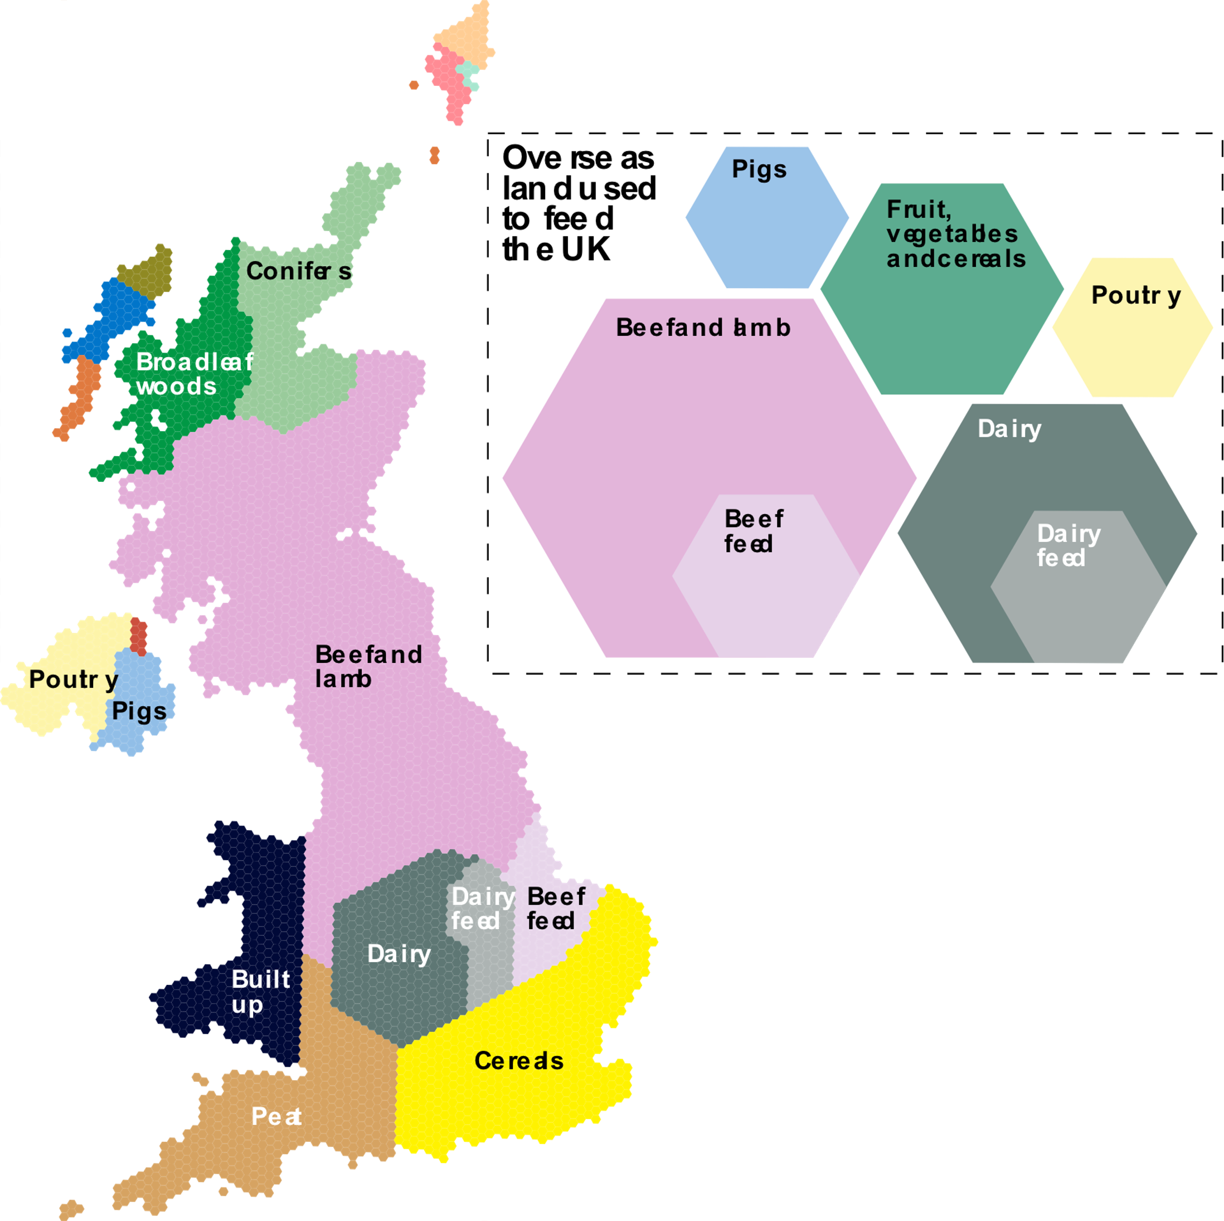
UK uses ~1.5x its land area to feed itself
We use 5x as much land for golf courses (red) as for orchards (blue)
This map shows the areas used to grow different types of food we eat.
Overall, around 70% of UK land, and an area about this size overseas, is used to grow our food.
Of this whole area, only 15% is used to grow the grains, fruit, and vegetables we directly consume.
All the plants we eat including potatoes (orange), fruit and veg (tan), and all imported cereals, fruit and veg (green) use just 15% of our total land footprint.
Pigs (blue) and poultry (yellow) combined use 5% of UK land, mostly for feed crops, but a larger area overseas
Our consumption of beef and lamb takes up 40% of the UK, and an area larger than Scotland overseas
Dairy
Note: this analysis draws on de Ruiter et al (which uses a top-down methodology) and Poore and Nemecek (which uses a bottom-up methodology). These have a high degree of agreement other than for total land footprint and share of land footprint overseas. The overall size area of land associated with UK diets is estimated to be between 24 and 38 million ha, and the relative share of this land that is in the UK versus overseas is around 50% (range 43-54%).
Peat
Source: National Food Strategy based on: Poore, J. and Nemecek, T. (2018). Reducing food’s environmental impacts through producers and consumers. Science 360:987-992. [online]; de Ruiter, H. Macdiarmid, J, Matthews, R. Et al. (2017). Total global agricultural land footprint associated with UK food supply 1986–2011. Global Environmental Change. 43. 72 - 81. [online]; ONS (2019). UK natural capital: urban accounts. [online]. WWF (2020). Bending the Curve: The Restorative Power of Planet-Based Diets. [online]; Forestry Commission. (2020). Forestry Statistics 2020: A compendium of statistics about woodland, forestry and primary wood processing in the United Kingdom. [National Statistics. [online]; CEH (2000). LAND COVER MAP 2000. [online; Corine Land Cover (2012); BBC (2017).
Notes:
Env diagnosis: Map shows a schematic of UK land use, including land used overseas:
In the UK, we use 72% of the land surface of the country to grow food plus a similar area overseas (hexagons), just to feed ourselves. This is overwhelmingly to grow animals that we eat: beef, lamb, and dairy alone use an area equivalent to that of Great Britain. All this land for animals provides just half our protein.

Slide 7
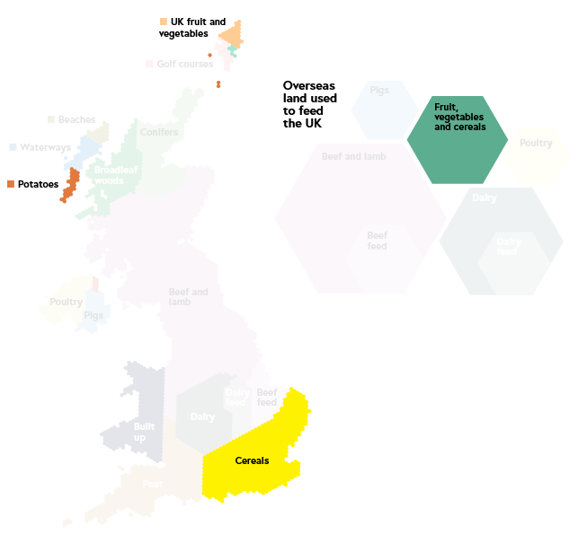
2/3 of our food calories, half our protein
Of this whole area, only 15% is used to grow the grains, fruit, and vegetables we directly consume.
85% is used to feed animals. These provide just 1/3 of our food calories.
Dairy
Note: this analysis draws on de Ruiter et al (which uses a top-down methodology) and Poore and Nemecek (which uses a bottom-up methodology). These have a high degree of agreement other than for total land footprint and share of land footprint overseas. The overall size area of land associated with UK diets is estimated to be between 24 and 38 million ha, and the relative share of this land that is in the UK versus overseas is around 50% (range 43-54%).
Source: National Food Strategy based on: Poore, J. and Nemecek, T. (2018). Reducing food’s environmental impacts through producers and consumers. Science 360:987-992. [online]; de Ruiter, H. Macdiarmid, J, Matthews, R. Et al. (2017). Total global agricultural land footprint associated with UK food supply 1986–2011. Global Environmental Change. 43. 72 - 81. [online]; ONS (2019). UK natural capital: urban accounts. [online]. WWF (2020). Bending the Curve: The Restorative Power of Planet-Based Diets. [online]; Forestry Commission. (2020). Forestry Statistics 2020: A compendium of statistics about woodland, forestry and primary wood processing in the United Kingdom. [National Statistics. [online]; CEH (2000). LAND COVER MAP 2000. [online; Corine Land Cover (2012); BBC (2017).
Notes:
Plants, on the other hand (now shown on the map), provide 2/3 of our food but use just 15% of the land area that feeds us. If we want to make space for nature and use land to sequester carbon we will need to change our diets.
INSIGHT: change diet, not just production

Slide 8
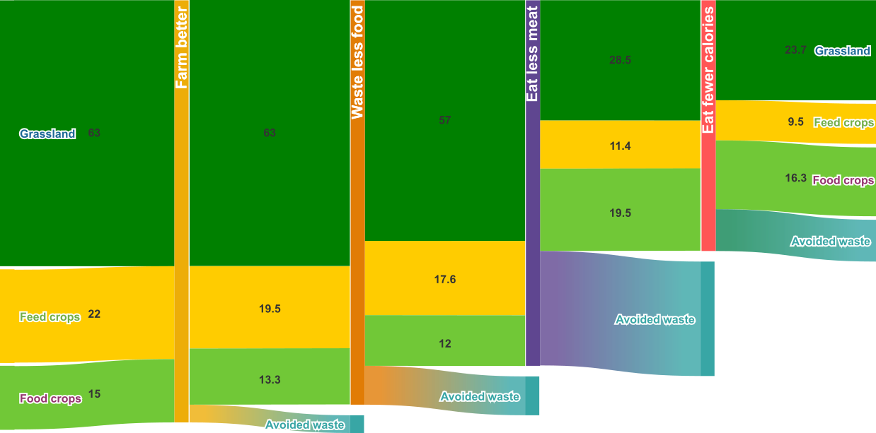
We can eat well on half the land
If we cut waste out of the system
Four steps could, in theory, halve the UK’s land footprint for food:
Closing arable yield gaps,
halving food waste,
limiting our meat consumption, and
eating enough to maintain a healthy weight.
Note: all figures percentages of the UK’s global land footprint for food
Source: National Food Strategy analysis based on: de Ruiter, H. Macdiarmid, J, Matthews, R. Et al. (2017). Total global agricultural land footprint associated with UK food supply 1986–2011. Global Environmental Change. 43. 72 - 81. [online]; Schils, R. Olesen, J. E. Kersebaum, K. Et al. (2018). Cereal yield gaps across Europe, European Journal of Agronomy, Volume 101, 109-120. [online]; Defra. (2019). Agriculture in the Uk, 2019. [online]; CEH. (2018). Quantifying the impact of future land use scenarios to 2050 and beyond - Final Report. [online]; Committee on Climate Change. (2020). The Sixth Carbon Budget, The UK's path to Net Zero. [online]; WRAP (2020). Food surplus and waste in the UK – key facts. [online]; Data Science Campus (2018). Evaluating Calorie Intake. [online].
Notes:
We could halve the land footprint of our diets, save nature, and still eat an omnivorous diet – our levels of meat consumption are the problem.

Slide 9
The solutions (in part!)
Notes:
We tried to be as small l liberal as possible with recommendations
They were designed to be implemented, not to be ideal, but sought to harness innovation and lead to further change over time

Slide 10
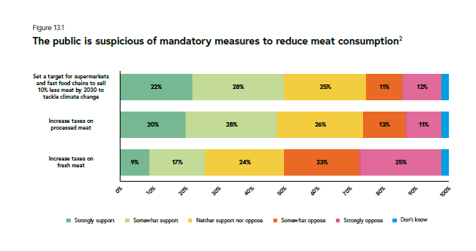
Diet is not easy to change
Notes:
Problem:
Public dialogues showed people don’t understand meat is the problem but can be persuaded to eat less.
But pricing interventions aren’t popular, especially ‘fresh’ meat. Further polling shows that the ‘strongly opposed’ group is likely to be highly politically active —> blocking minority.
We needed a different strategy.
Basically my recipe would be:
find ways for the government and supermarkets to help us (procurement, sales targets and ).

Slide 11
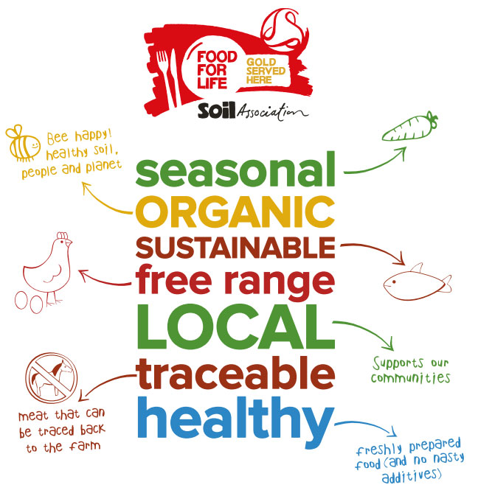
Public sector leadership in healthy and sustainable diets
Revise procurement rules: more plants, less HFSS (including meat)
How would it work?
Reform and mandate the Government Buying Standards for Food
Encourage small and local suppliers through the South West trial.
A mandatory accreditation scheme to support caterers to raise standards.
Impact
1.9 billion healthy and sustainable meals to 13 million people a year
Increase consumption of fruit and vegetables in children by a third.
Government leadership incentivises innovation and investment into healthy and sustainable food
Notes:
Quality of public sector food is not consistent and poor in places. It is often not healthy, sustainable or appealing.
Current standards are not applied consistently across public sector settings and where they are applied do not promote a positive food culture.
Government cannot expect individuals and organisations to make changes to the food they eat and serve if it doesn’t lead by example.

Slide 12
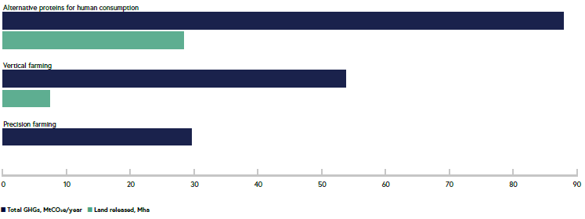
Invest £1 billion to make low carbon food and farming cheap
How would it work?
Fund innovation to make better food cheaper and
Prioritise alternative proteins, regenerative farming, and methods for reducing livestock methane emissions
Two What Works Centres with ‘farmer-led’ approaches
Impact
Longterm net economic benefit to the UK of £3.5bn.
Innovation in methane reduction could reduce GHGs by around 7% of total agricultural emissions a year.
Reduction in land use to meet climate and nature goals.
Notes:
The UK already has world class food science and agricultural research but is less effective than comparable countries at innovation – the successful application of ideas.
Identified
reducing the environmental impact of the meat we make (methane suppressants, poss also agroecology)
eat more alternatives to meat (alternative proteins)

Slide 13







Social pressure
Mandatory Reporting (cf mandatory carbon reporting)
Supported by..
How would it work?
Impact
All food businesses with over 250 employees should have a legal duty to publish annual data on their sales of various product types as well as food waste.
Report sales of:
HFSS food
Protein (by type and origin)
Sales of fruit and vegetables
Sales of major nutrients
Food waste
Total food and drink sales
Identify where businesses are making progress in supporting healthy and sustainable diets and where they are not
To encourage action by businesses:
Increase the availability of healthier products
Reformulating existing products
Improving the marketing of healthy products
Notes:
Additional info to create social pressure in favour of healthier more sustainable food.
Mandatory reporting for retailers, restaurants and fast food outlets, contract caterers, wholesalers, manufacturers and online ordering platforms
Figures to be reported in volume and value in sterling
Should be reviewed every five years
Data disclosure brings public scrutiny and encourages businesses to take action to improve their practices

Slide 14
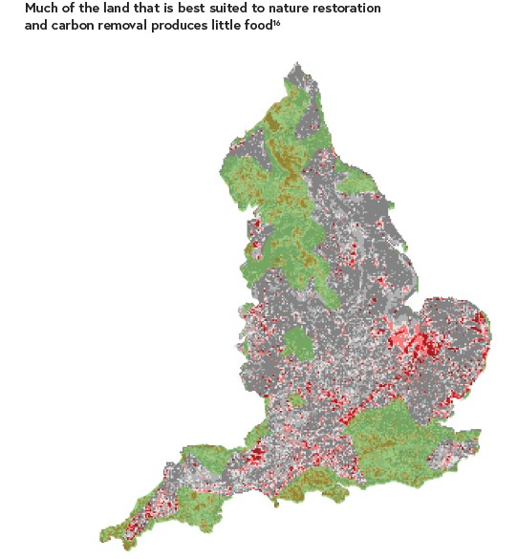
Guarantee the budget for agricultural payments until at least 2029
And segment it so it is spatially coherent
How would it work?
Impact
To help farmers transition to more sustainable land use
£500-£700m for schemes to encourage carbon removal and habitat restoration
£2.2bn to ELMs
£200m for improving farm productivity and innovation
An extra 7% of land in England to be protected for nature by 2035
410,000 hectares of additional woodland in England
325,000 hectares of upland peat restored
200,000 hectares of agricultural land managed for nature which is not suited to farms e.g. marshes and species rich grassland
Notes:
Why
The aim is to incentivise farmers to convert less productive land into nature-rich, carbon sequestering landscapes.
Effectively becomes a rural income guarantee – must provide for farmers
Unproductive land is well suited to creating environmentally friendly landscapes
This will not threaten food security- the least productive 20% of farmland only produces 3% of our calories
10% of agricultural land in England will need to transition to woodland, restored peat, other semi natural habitats and energy crops by 2035, as part of the UK road to net zero

Slide 15
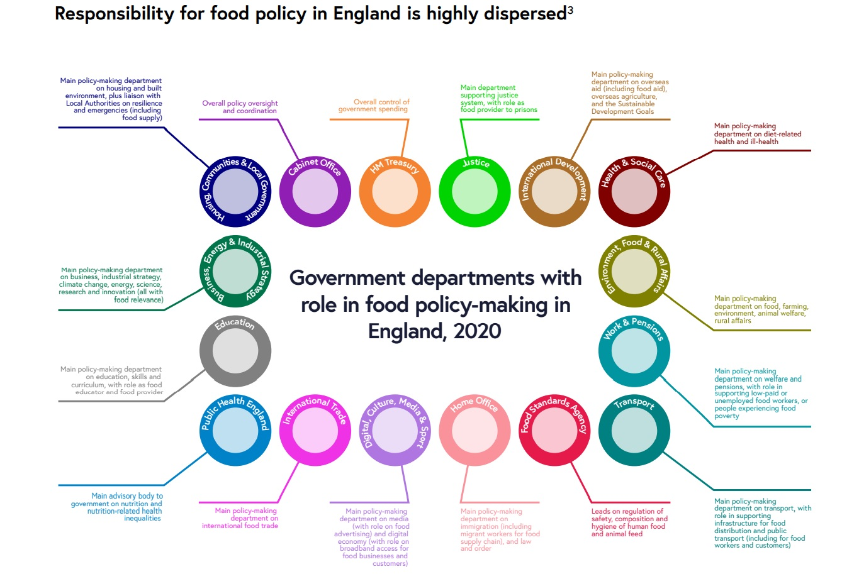
Set clear targets and legislate for long-term change
How would it work?
A Good Food Bill including diet related health targets
Formally extend the FSA remit to drive forward progress and hold government to account.
Impact
Set the long term goals and ensure progress towards net zero, nature recovery and better health
Continuity of ambition on these areas regardless of political party
Notes:
Governance is fragmented etc … see chart.
Need a means to underpin the UK’s long-term progress towards net zero, nature recovery and better health.
Good Food Bill
Bill would require government to prepare Actions Plans every 5 years to make progress beyond the National Food Strategy
Bill would set a long term statutory target to improve diet-related health
Commit Govt to establish and update a Reference Diet to be used by all public bodies in food related policy making and procurement
Oblige all public sector organisations to comply with procurement standards
Commit the FAS to developing a harmonised and consistent approach to labelling for environmental standards
Require LAs to develop food strategies
Require business to publish data on the health and environmental impact of their product portfolios
FSA
FSA remit changed from consumer interest to a ‘collective interest’ in tackling climate change, nature recovery and promoting health
FSA to advice Government
FSA to consult with the Office for Environmental Protection, the Climate Change Committee, the Office for Health Protection and the Food and Drink Sector Council in drawing up its advice and reports
Rationale
We need legally binding targets, like we have for carbon, for diet related disease which aim to reduce diet related disease
Maintaining momentum and focus for large scale change is difficult- previous attempts have not lasted. By mirroring what the CCC do, pressure to act can be maintained on government
Like in the USA, a reference diet should be used to ensure that diets incorporate health and sustainability and this is reflected in public procurement and policy
National strategies only work when they can be delivered on the ground. Local initiatives are essential to the success of the Strategy

